Slide 1
Using Windows PowerShell to create scripts your users want to use
Using Show-Command & Out-GridView
to capture & present data

Slide 2
Get-Info -Presenter ‘Cory Knox’
Name: Cory Knox
Profession: Software Developer for Chocolatey Software
Background: Over a decade in End User Computing
Interests: PowerShell, C#, whatever language is required to fix issues in Open Source projects

Slide 3
What’s wrong with scripts
Nothing
When written for yourself
The users don’t live in the shell
Not as discoverable

Slide 4
What GUI options do I have?
Using .Net
Perhaps a little bit of XAML
I know, WinForms!
ShowUI
Why not use features built into Windows PowerShell?

Slide 5
But why would I use that option?
No need to reinvent the wheel
Design decisions are made for you
Already included with Windows PowerShell
Have I mentioned the lack of design skills needed?

Slide 6
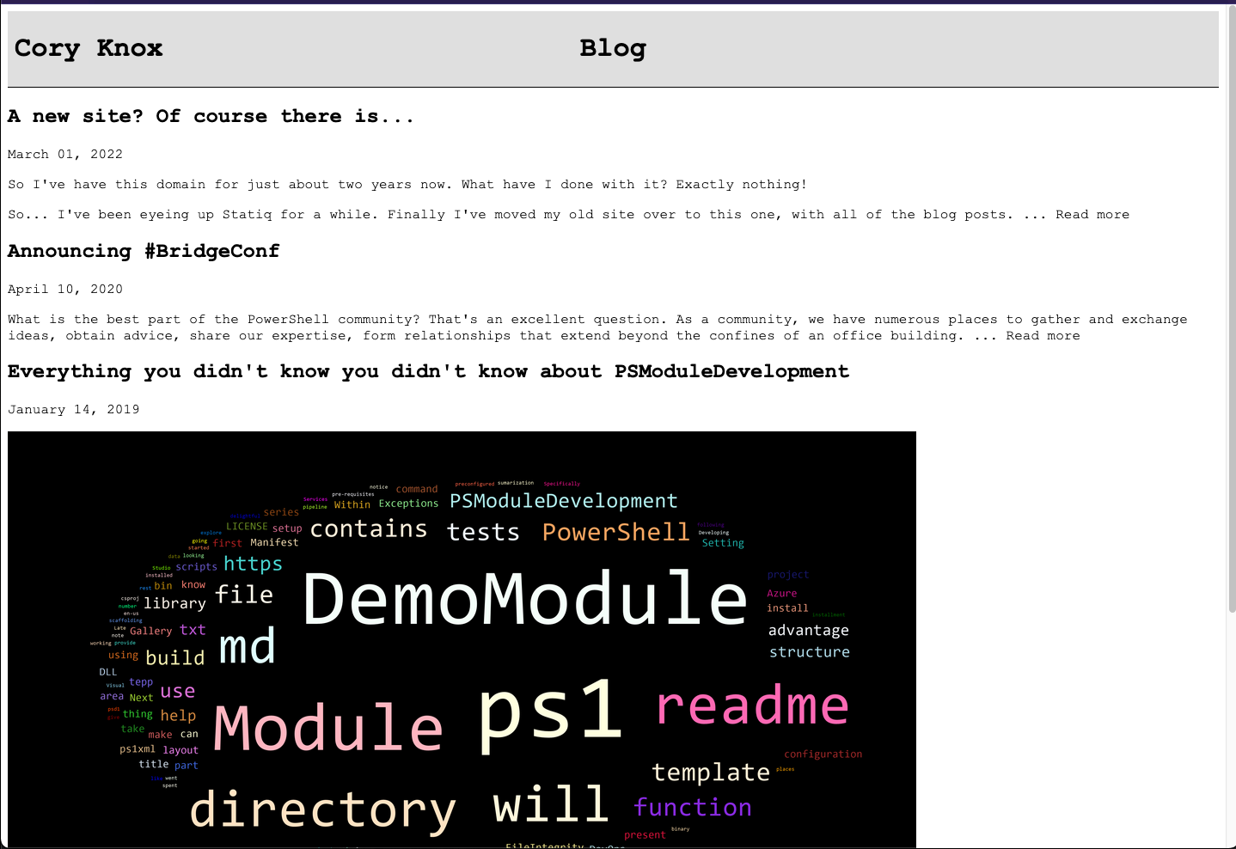

Slide 7
Show-Command
Present a graphical interface
Validate input
Execute your script

Slide 8
Out-GridView
Present data
Allow sorting
Filtering
Accept selection

Slide 9
Ok, it’s built in. But how do I use it?
Function
Launcher script
Out-GridView tricks
-PassThru/-Wait
-OutputMode
-Title

Slide 10
Demo Time!

Slide 11
Questions?
Please come up to the webcam to ask any questions

Slide 12
Summary
Function
Launcher script
Out-GridView tricks
-PassThru/-Wait
-OutputMode
-Title

Slide 13
Resources
https://docs.microsoft.com/en-us/powershell/module/microsoft.powershell.utility/out-gridview
https://docs.microsoft.com/en-us/powershell/module/microsoft.powershell.utility/show-command
https://github.com/PowerShell/GraphicalTools - on hold waiting for .Net MAUI
https://github.com/ShowUI/ShowUI

Slide 14
Get-Contact -Presenter ‘Cory Knox’
Twitter: CoryKnox
GitHub: corbob
GitLab: corbob
Website: https://coryknox.dev

